Slide 1

Friday 23rd May 2025

Slide 2
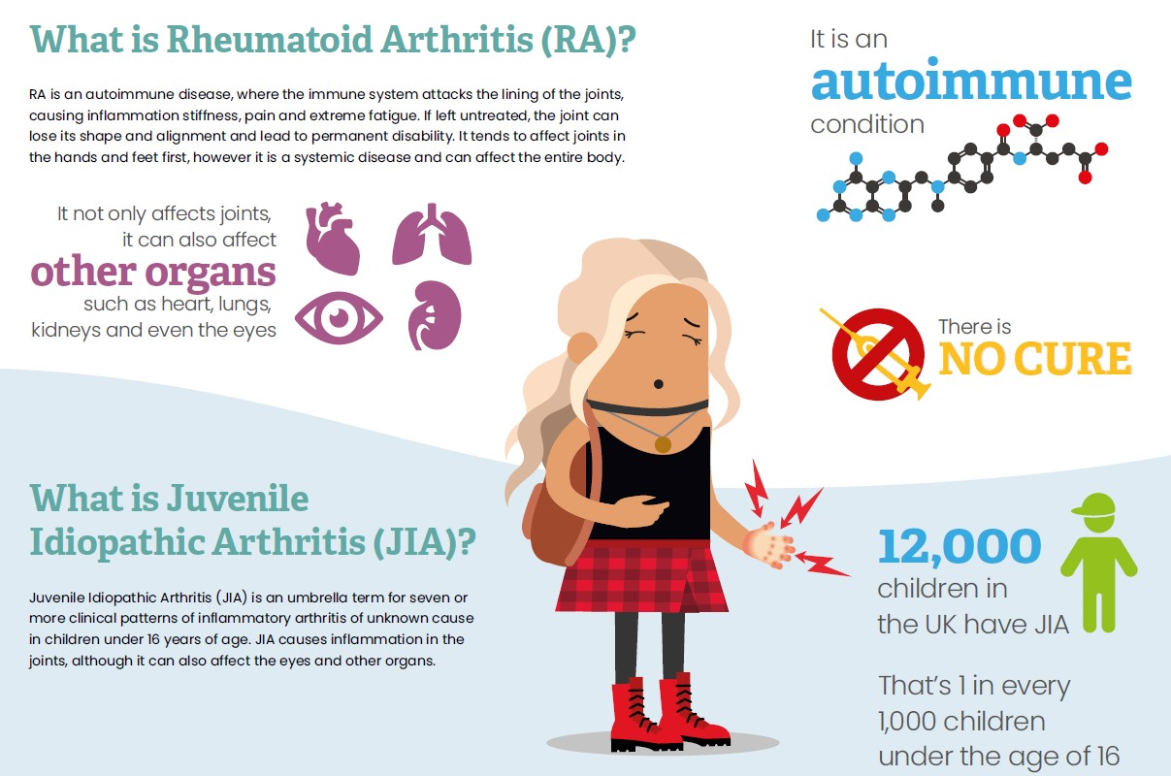

What is Juvenile Idiopathic Arthritis (JIA)?
JIA is a condition that causes joints to become swollen in children under the age of 16.
JIA is an autoimmune condition, which means the body’s defence system (the immune system) starts attacking healthy tissue
(in this case the joints) and we are not sure why it does this.

Slide 3

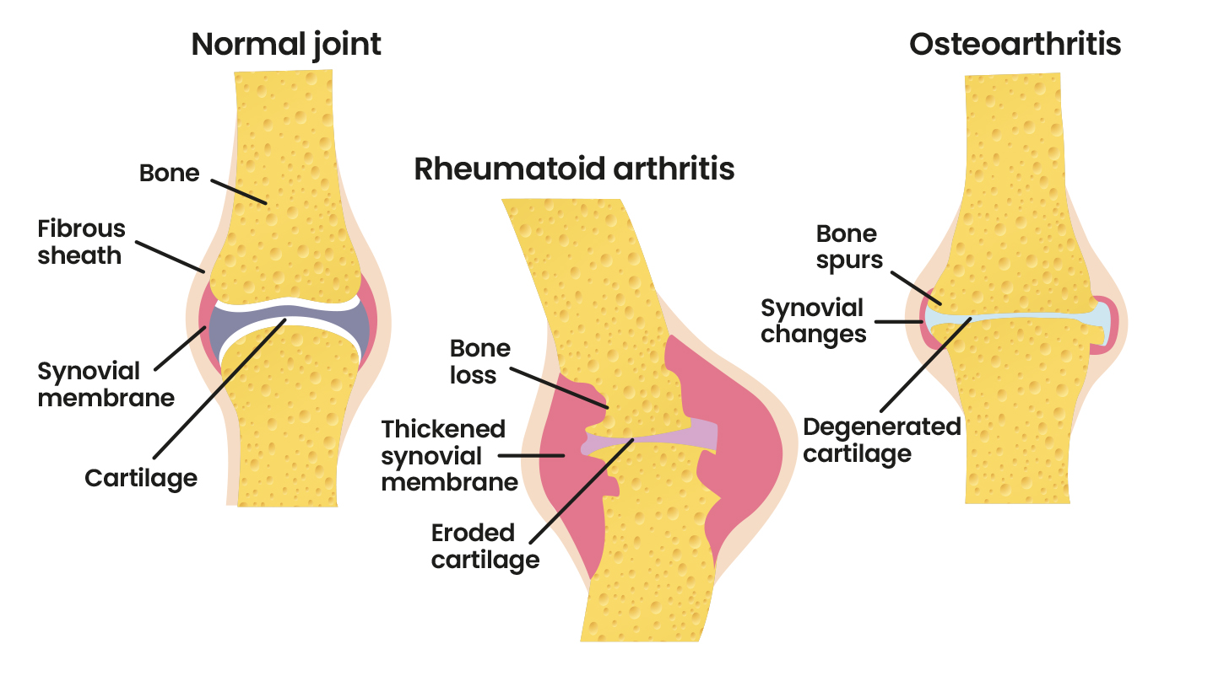
What is Juvenile Idiopathic Arthritis (JIA)?
In JIA, the immune system attacks the lining of the joint, which can cause swelling, leading to pain and stiffness.
JIA
JIA can also affect parts of the body outside of the joints.
When people hear the word ‘arthritis’ they often think of osteoarthritis, which is caused by wear and tear and is more common in older people.

Slide 4

How does JIA affect me?
My name is…..
I was diagnosed with JIA when I was ………. years old
We found out I had JIA because……….
I sometimes have JIA flares and that means that……
Notes:
Please edit this slide to include details of your own condition or remove the slide as necessary.

Slide 5
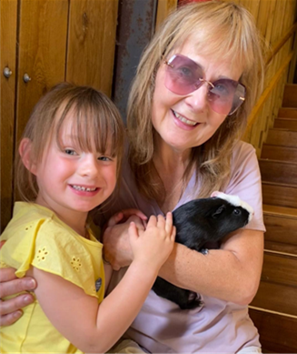
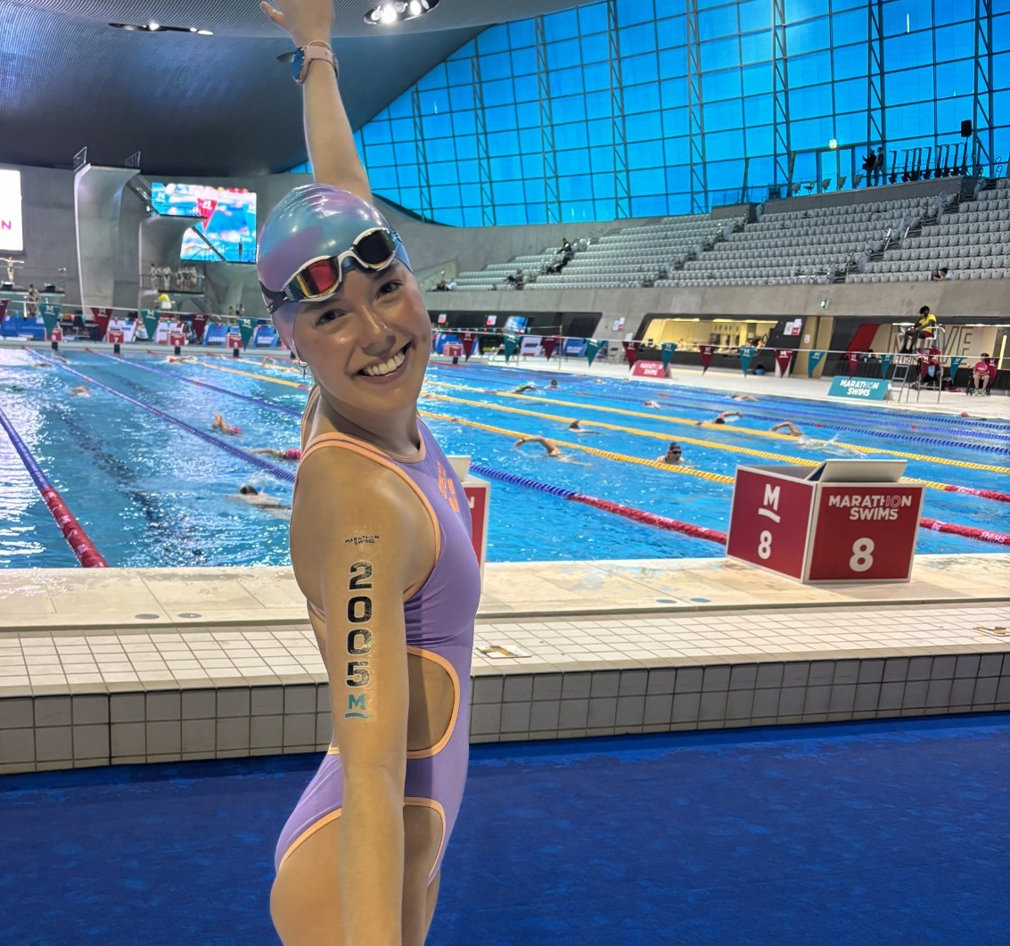
How does JIA affect young people?
“Willow, my loving little granddaughter, was diagnosed with juvenile idiopathic arthritis (JIA) when she was only 18 months old. Since then she has had ongoing treatment for her affected joints. Willow, now 6 years old, is such a beautiful girl who never complains and takes it all in her stride.” - Kirsten
“When my JIA flared particularly badly at university, I went from being very sporty to barely being able to walk, write, hold cutlery – quite literally overnight! Trying to see light at the end of the tunnel of a ‘normal’ life was very tough…but swimming really helped my mental and physical recovery and is one of the few things I began to be able to do where I felt strong and like my ‘old self’” - Darcey

Slide 6
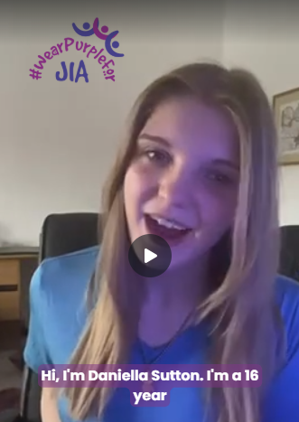
Meet Daniella Sutton, aged 16
Watch video of Daniella Sutton

Slide 7
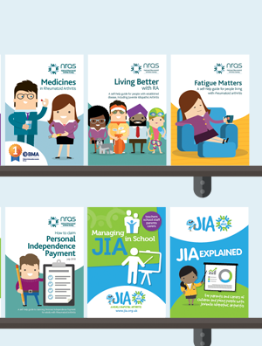

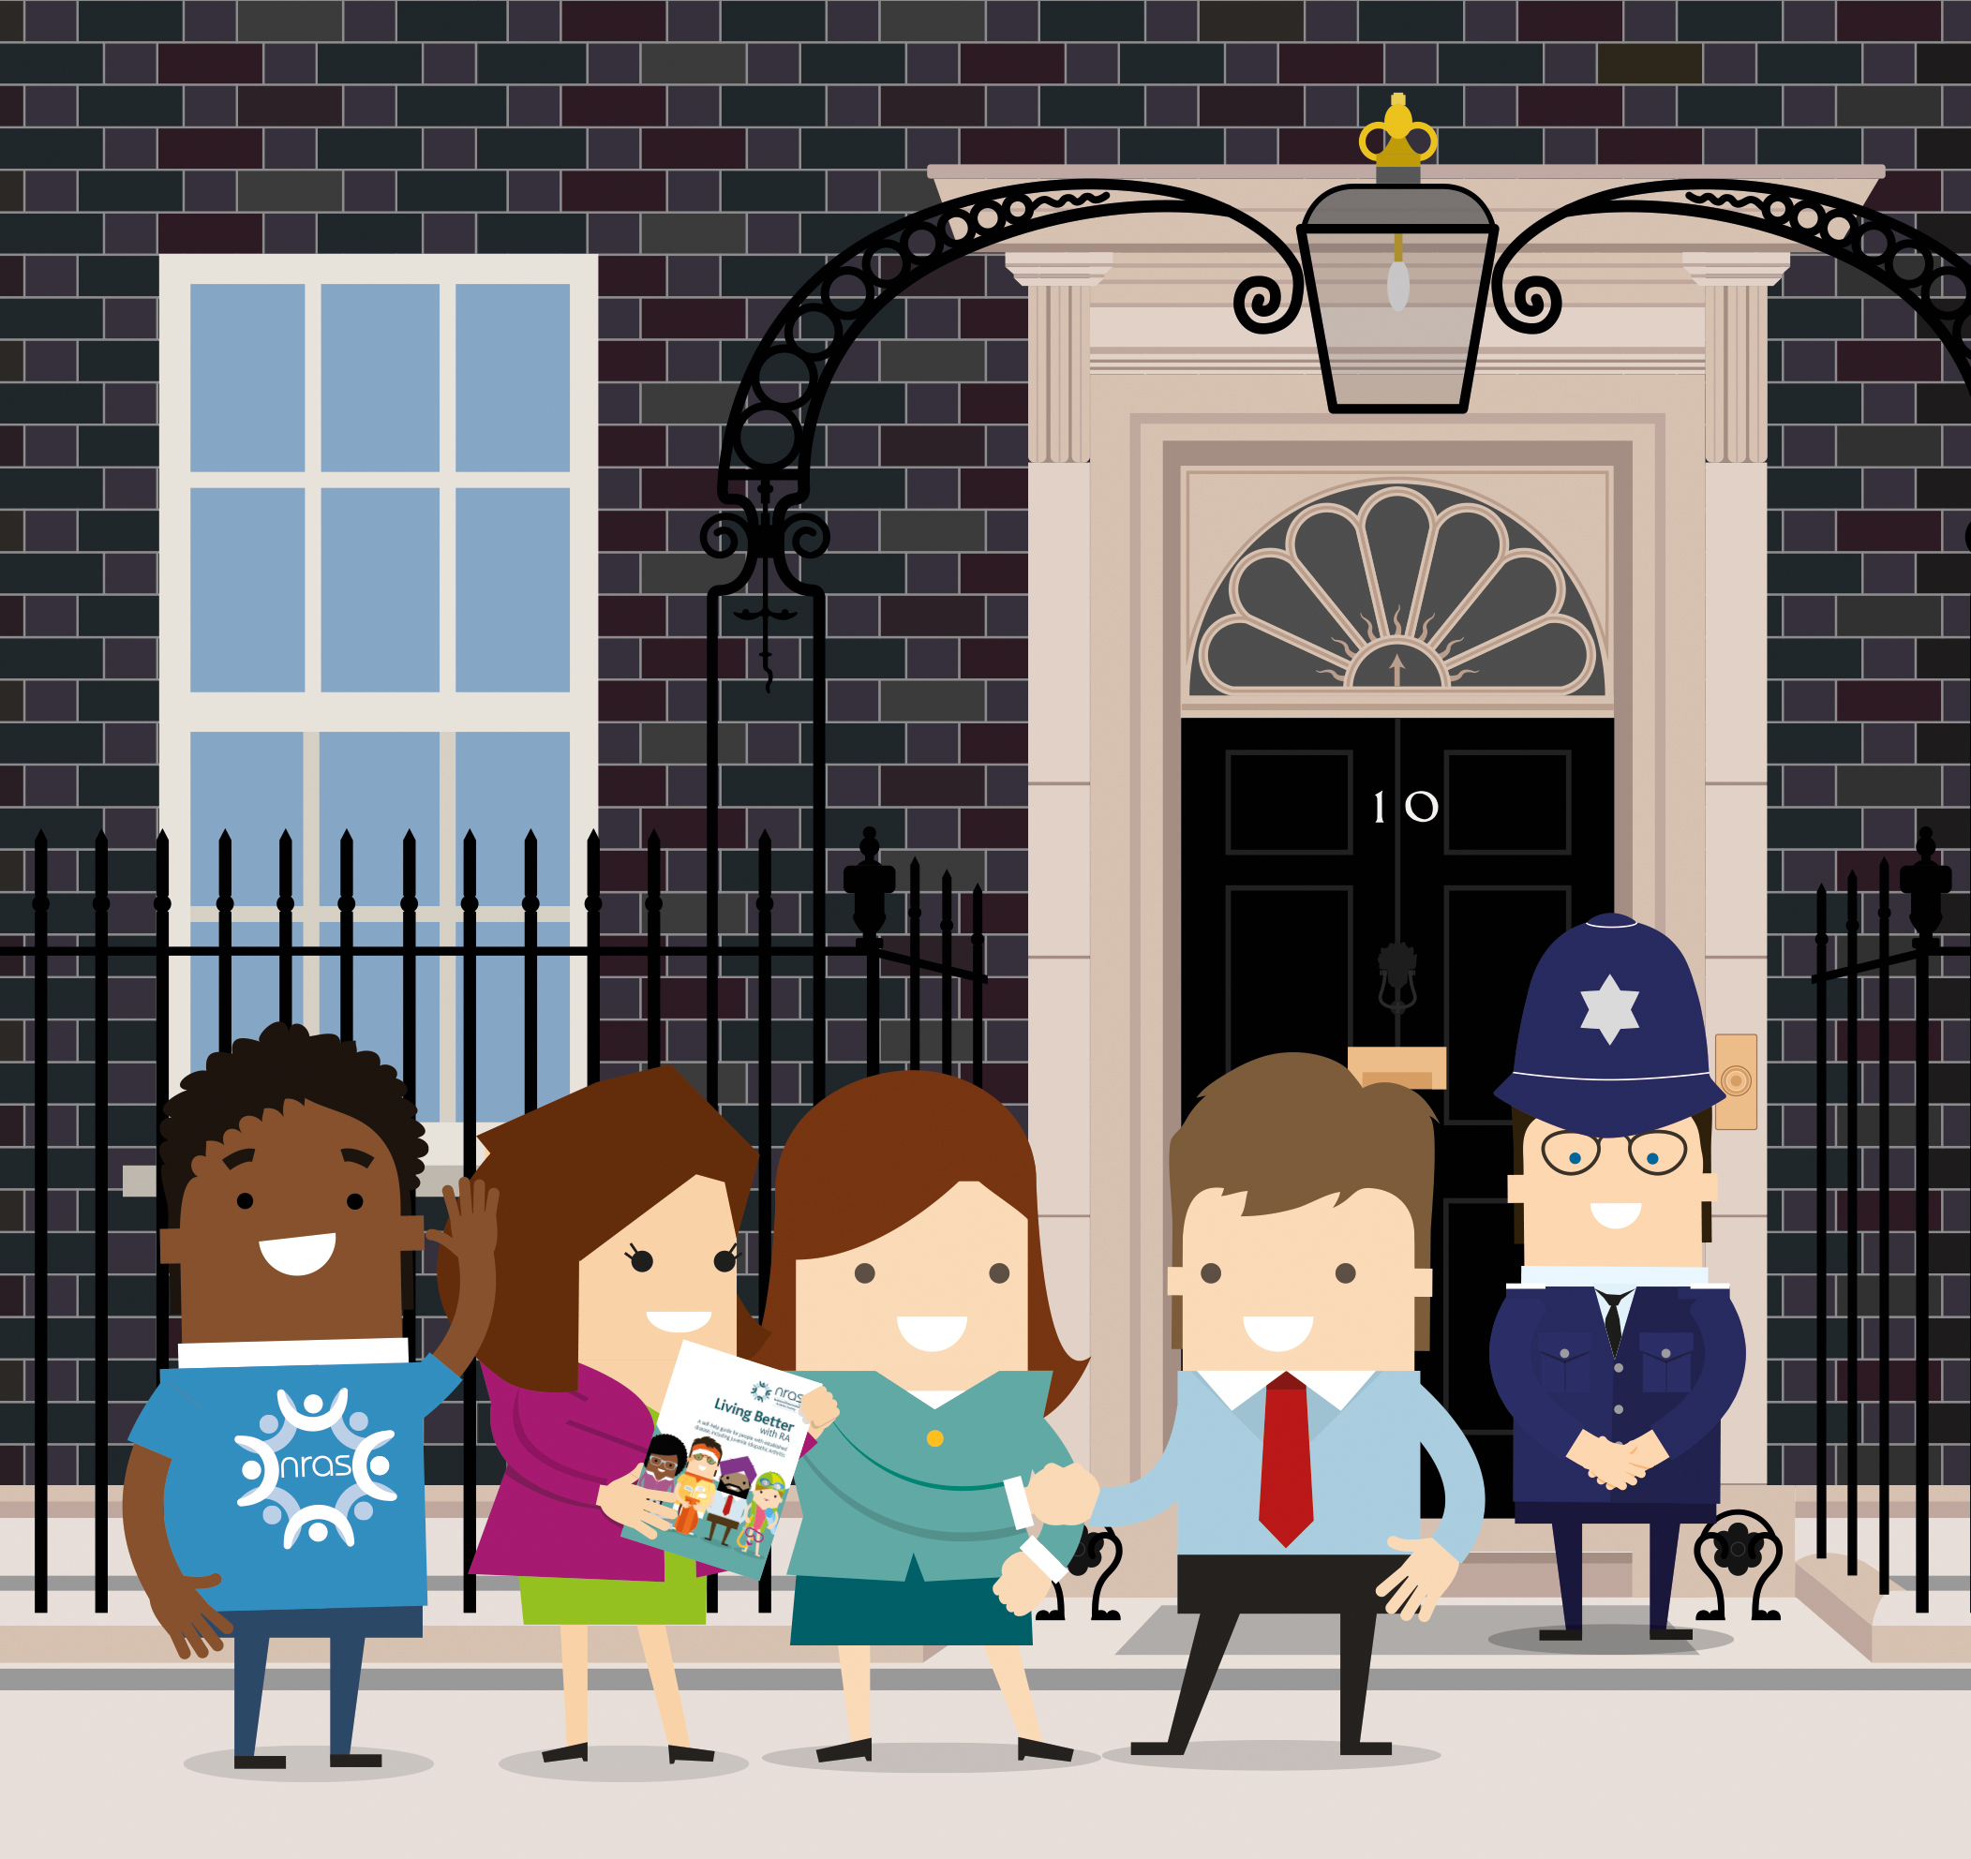
How does NRAS help people with JIA?
Free Publications
Helpline
Raising Awareness
Notes:
Free Publications – we put together free leaflets to tell people more about JIA and give these to families, schools, health centres and organisations so they can learn about JIA.
Helpline – we offer a free telephone service to anyone affected by JIA so they can call up for support, help and information.
Raising Awareness – we work with the Healthcare service and the UK government to make sure that young people with JIA are supported with the right treatments and medication as quickly as possible.

Slide 8
There is no cure but we can help!
£100 could pay for 60 booklets to help children and schools learn about JIA
£150 could pay for 15 thirty-minute helpline calls, to help children with JIA and their families
£200 could pay for 7 one-hour meetings with a family to talk through a recent diagnosis of JIA

Slide 9
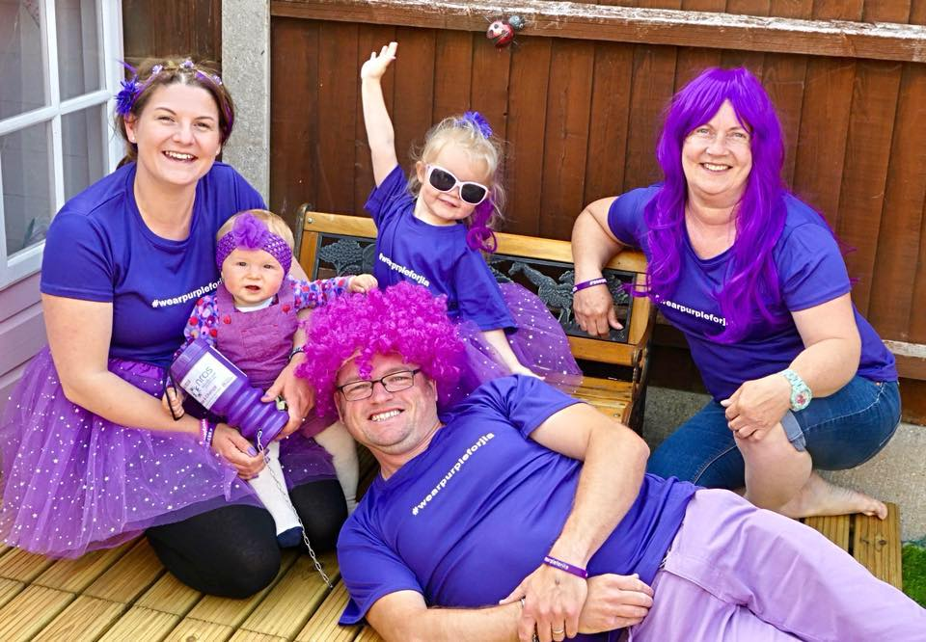
Let’s Wear Purple to help young people with JIA!
Wear Purple Day on Friday 23rd May!
Wear Purple for a donation
Purple Bake Sale
Purple Crazy Hair Day
Purple Party
Donate [£2] to Wear Purple for
children with arthritis
Notes:
These are Fundraising Event suggestions – please edit the information on this slide or delete as necessary.

Slide 10

Let’s Wear Purple to help young people with JIA!
Purple Gunge Challenge on [date]
Mr X
Mrs Y
Ms Z
Donate and vote for who to Gunge!
Please give whatever you can to help change the lives of young people with arthritis.
Notes:
This is a Fundraising Event suggestion – please edit the information on this slide or delete as necessary.

Slide 11

Thank you for all your support!
We are so grateful for all you are doing and can’t wait to hear your Purple plans!
Don’t forget to tag us on your socials:
#WearPurpleForJIA #PurpleGungeChallenge
Email fundraising@nras.org.uk with any questions, purple pictures and videos – we can’t wait to see them!

